Slide 1
Chapter: Transactions
Transaction Concept
Transaction State
Concurrent Executions
Serializability

Slide 2
Transaction Concept
A transaction is a unit of program execution that accesses and possibly updates various data items.
A transaction must see a consistent database.
During transaction execution the database may be temporarily inconsistent.
When the transaction completes successfully (is committed), the database must be consistent.
After a transaction commits, the changes it has made to the database persist, even if there are system failures.
Multiple transactions can execute in parallel.
Two main issues to deal with:
Failures of various kinds, such as hardware failures and system crashes
Concurrent execution of multiple transactions

Slide 3
ACID Properties
A transaction is a unit of program execution that accesses and possibly updates various data items.To preserve the integrity of data the database system must ensure:
Atomicity. Either all operations of the transaction are properly reflected in the database or none are.
Consistency. Execution of a transaction in isolation preserves the consistency of the database.
Isolation. Although multiple transactions may execute concurrently, each transaction must be unaware of other concurrently executing transactions. Intermediate transaction results must be hidden from other concurrently executed transactions.
That is, for every pair of transactions T_{i} and T_{j}, it appears to T_{i} that either T_{j}, finished execution before T_{i} started, or T_{j} started execution after T_{i} finished.
Durability. After a transaction completes successfully, the changes it has made to the database persist, even if there are system failures.

Slide 4
Example of Fund Transfer
Transaction to transfer $50 from account A to account B:
1. read(A)
2. A := A – 50
3. write(A)
4. read(B)
5. B := B + 50
6. write(B)
Atomicity requirement — if the transaction fails after step 3 and before step 6, the system should ensure that its updates are not reflected in the database, else an inconsistency will result.
Consistency requirement – the sum of A and B is unchanged by the execution of the transaction.

Slide 5
Example of Fund Transfer (Cont.)
Isolation requirement — if between steps 3 and 6, another transaction is allowed to access the partially updated database, it will see an inconsistent database (the sum A + B will be less than it should be).
Isolation can be ensured trivially by running transactions serially, that is one after the other.
However, executing multiple transactions concurrently has significant benefits, as we will see later.
Durability requirement — once the user has been notified that the transaction has completed (i.e., the transfer of the $50 has taken place), the updates to the database by the transaction must persist despite failures.

Slide 6
Transaction State
Active – the initial state; the transaction stays in this state while it is executing
Partially committed – after the final statement has been executed.
Failed -- after the discovery that normal execution can no longer proceed.
Aborted – after the transaction has been rolled back and the database restored to its state prior to the start of the transaction. Two options after it has been aborted:
restart the transaction; can be done only if no internal logical error
kill the transaction
Committed – after successful completion.

Slide 7
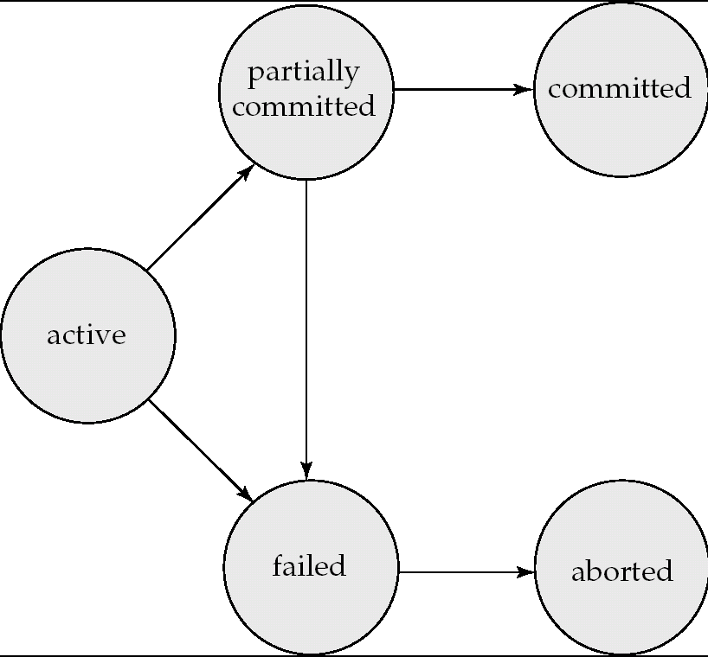
Transaction State (Cont.)

Slide 8
Concurrent Executions
Multiple transactions are allowed to run concurrently in the system. Advantages are:
increased processor and disk utilization, leading to better transaction throughput: one transaction can be using the CPU while another is reading from or writing to the disk
reduced average response time for transactions: short transactions need not wait behind long ones.
Concurrency control schemes – mechanisms to achieve isolation; that is, to control the interaction among the concurrent transactions in order to prevent them from destroying the consistency of the database

Slide 9
Schedules
Schedule – a sequences of instructions that specify the chronological order in which instructions of concurrent transactions are executed
a schedule for a set of transactions must consist of all instructions of those transactions
must preserve the order in which the instructions appear in each individual transaction.
A transaction that successfully completes its execution will have a commit instructions as the last statement (will be omitted if it is obvious)
A transaction that fails to successfully complete its execution will have an abort instructions as the last statement (will be omitted if it is obvious)

Slide 10
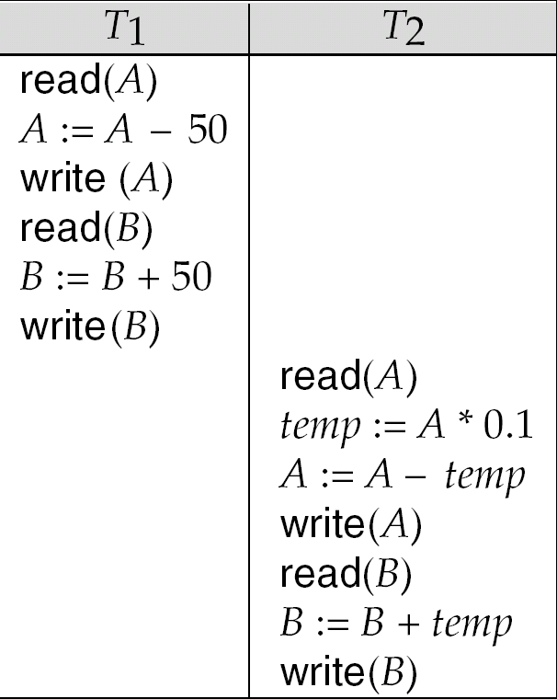
Schedule 1
Let T₁ transfer $50 from A to B, and T₂ transfer 10% of the balance from A to B.
A serial schedule in which T₁ is followed by T₂:

Slide 11
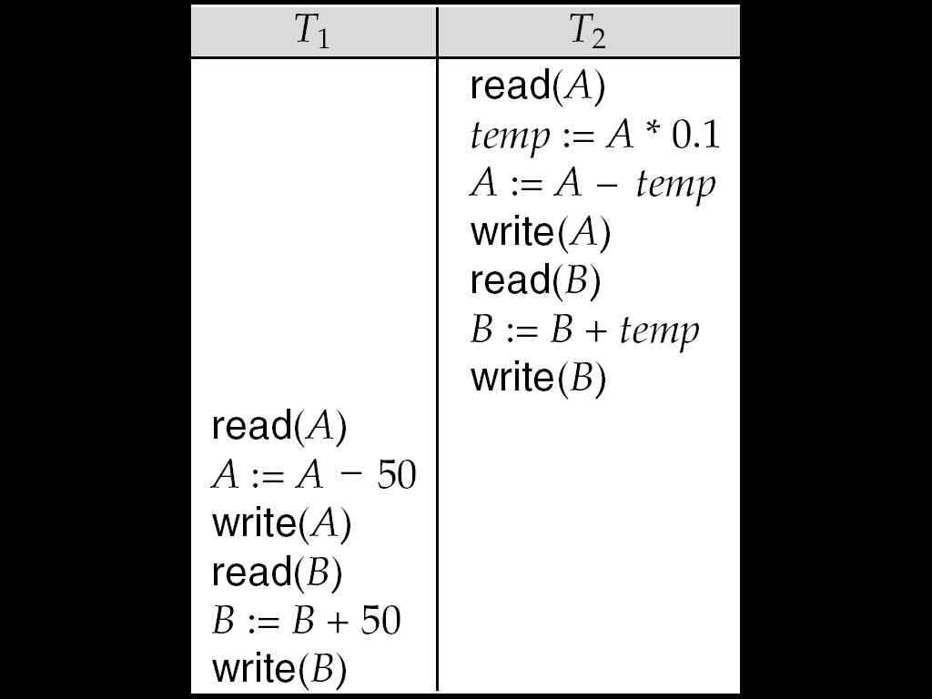
Schedule 2
A serial schedule where T₂ is followed by T₁

Slide 12
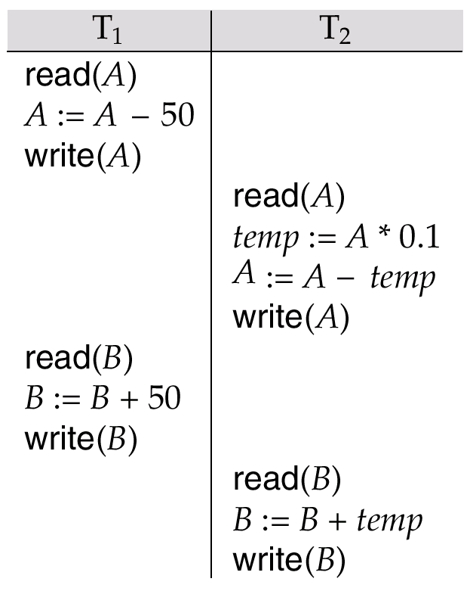
Schedule 3
Let T₁ and T₂ be the transactions defined previously. The following schedule is not a serial schedule, but it is equivalent to Schedule 1.
In Schedules 1, 2 and 3, the sum A + B is preserved.

Slide 13
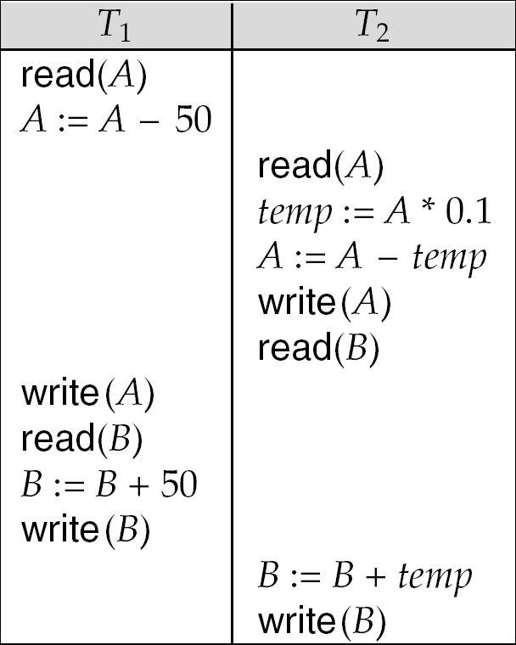
Schedule 4
The following concurrent schedule does not preserve the value of (A + B).

Slide 14
Serializability
Basic Assumption – Each transaction preserves database consistency.
Thus serial execution of a set of transactions preserves database consistency.
A (possibly concurrent) schedule is serializable if it is equivalent to a serial schedule. Different forms of schedule equivalence give rise to the notions of:
1. conflict serializability
2. view serializability
We ignore operations other than read and write instructions, and we assume that transactions may perform arbitrary computations on data in local buffers in between reads and writes. Our simplified schedules consist of only read and write instructions.

Slide 15
Conflicting Instructions
Instructions l_{i} and l_{j} of transactions T_{i} and T_{j} respectively, conflict if and only if there exists some item Q accessed by both l_{i} and l_{j}, and at least one of these instructions wrote Q.
1. l_{i} = read(Q), l_{j} = read(Q). l_{i} and l_{j} don’t conflict. 2. l_{i} = read(Q), l_{j} = write(Q). They conflict. 3. l_{i} = write(Q), l_{j} = read(Q). They conflict 4. l_{i} = write(Q), l_{j} = write(Q). They conflict
Intuitively, a conflict between l_{i} and l_{j} forces a (logical) temporal order between them.
If l_{i} and l_{j} are consecutive in a schedule and they do not conflict, their results would remain the same even if they had been interchanged in the schedule.

Slide 16
Conflict Serializability
If a schedule S can be transformed into a schedule S´ by a series of swaps of non-conflicting instructions, we say that S and S´ are conflict equivalent.
We say that a schedule S is conflict serializable if it is conflict equivalent to a serial schedule

Slide 17
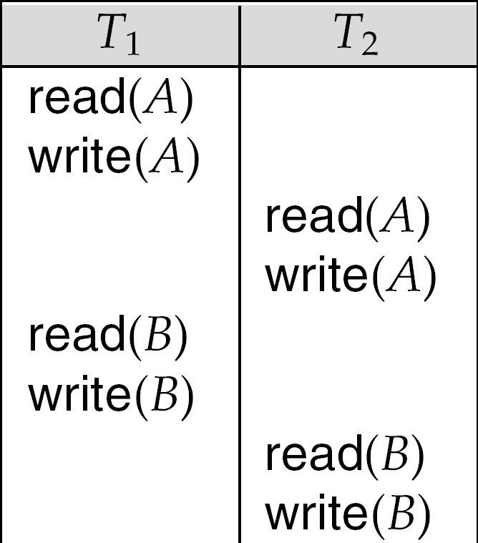
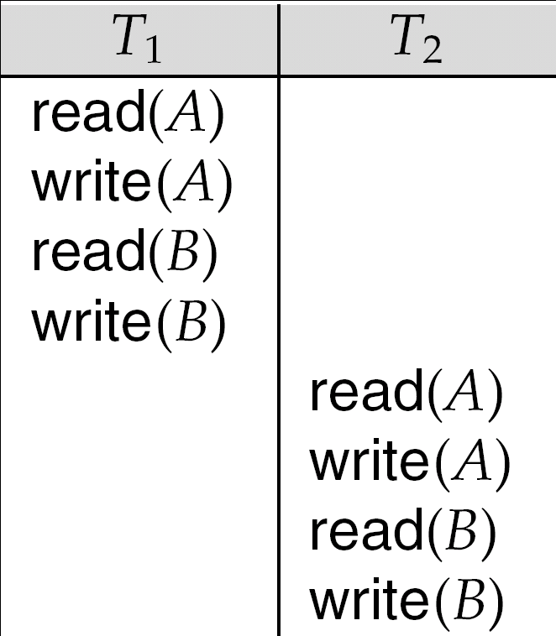
Conflict Serializability (Cont.)
Schedule 3 can be transformed into Schedule 6, a serial schedule where T₂ follows T₁, by series of swaps of non-conflicting instructions.
Therefore Schedule 3 is conflict serializable.
Schedule 3
Schedule 6

Slide 18
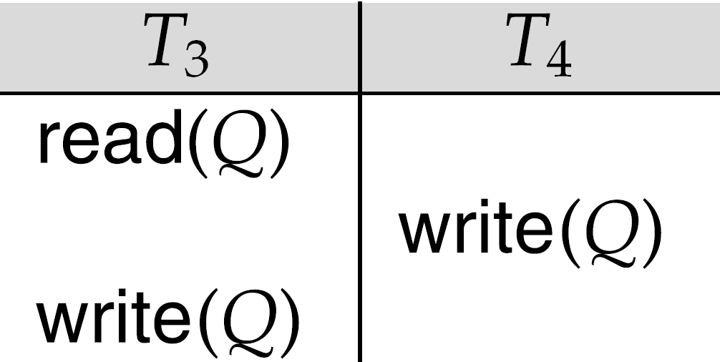
Conflict Serializability (Cont.)
Example of a schedule that is not conflict serializable:
We are unable to swap instructions in the above schedule to obtain either the serial schedule < T₃, T₄ >, or the serial schedule < T₄, T₃ >.

Slide 19
View Serializability
Let S and S´ be two schedules with the same set of transactions. S and S´ are view equivalent if the following three conditions are met:
1. For each data item Q, if transaction T_{i} reads the initial value of Q in schedule S, then transaction T_{i} must, in schedule S´, also read the initial value of Q.
2. For each data item Q if transaction T_{i} executes read(Q) in schedule S, and that value was produced by transaction T_{j} (if any), then transaction T_{i} must in schedule S´ also read the value of Q that was produced by transaction T_{j} .
3. For each data item Q, the transaction (if any) that performs the final write(Q) operation in schedule S must perform the final write(Q) operation in schedule S´.
As can be seen, view equivalence is also based purely on reads and writes alone.

Slide 20
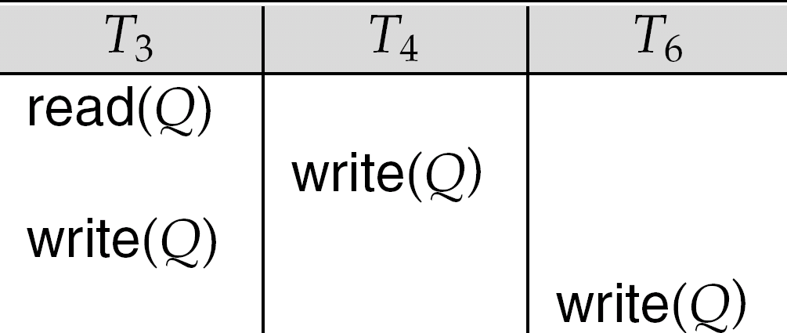
View Serializability (Cont.)
A schedule S is view serializable it is view equivalent to a serial schedule.
Every conflict serializable schedule is also view serializable.
Below is a schedule which is view-serializable but not conflict serializable.

